Slide 1

Web E-Wallet: A GCP Implementation
Presented by: Latifat Yisa, Hasan Sarfraz, Mahina Ahmed
Supervised by: Jaspreet Bhatia
Project Group: 1

Slide 2

Business Problem
In this digital age, businesses, especially in emerging markets, face challenges in providing seamless, secure, and cost-effective payment solutions. Customers demand a convenient way to store, transfer, and transact money digitally without the complexity of traditional banking.
The "E-wallet" is a web-based application designed to revolutionize the way users manage their funds, make payments, and transfer money.

Slide 3

Objective and Scope
By building this software, we aim to offer secure and convenient digital financial transactions for users with an easy to navigate UI/UX whiles offering apt backend services.
The application allows users to register for an account, manage funds, view transaction histories, and transfer money to other users.
Supports operations like account creation, balance checks, credit and debit transactions, and user authentication.
Users can fund their wallets using credit/debit cards and transfer funds to recipients via email or wallet number.

Slide 4
cost-benefit analysis for using GCP versus On-Premise Resources
Focus | GCP | On-Premise
Aspect | GCP | On-Premise
Initial Setup Costs | Minimal; pay-as-you-go. No upfront hardware investment. | High upfront costs for purchasing servers, storage, and networking equipment.
Scalability Costs | Flexible scaling; pay only for resources used. | Expensive and time-consuming; requires new hardware purchases.
Maintenance Costs | Managed by Google (updates, patches, and hardware). | Requires dedicated IT staff and resources for ongoing maintenance.
Resource Utilization | Highly efficient through auto scaling. | Often underutilized, leading to sunk costs.

Slide 5
WHY GCP?
GCP offers affordable cloud services for small to mid sized business with serverless options which handles our infrastructure, while we focus more on development and business.
Our architecture setup is completely serverless and configured for scaling which gcp is equipped to handle once the volume of transactions, customer base, traffic etc. increases over time.

Slide 6





Components Of GCP Adopted
To achieve the set objective, we have adopted the use of these GCP’s cloud services listed below:
VPC
Artifacts Registry
Cloud Run
App Engine
Cloud SQL

Slide 7



Components Of GCP Adopted
To achieve the set objective, we have adopted the use of these GCP’s cloud services listed below:
Pub Sub
Cloud Function
Cloud Storage
Log Explorer

Slide 8
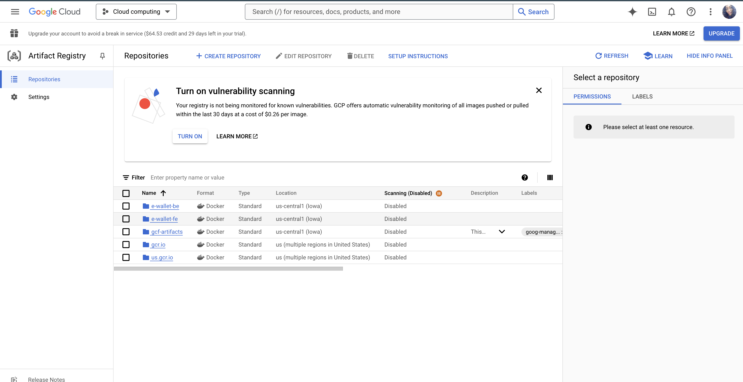
Services: Artifacts Registry for Docker Image

Slide 9
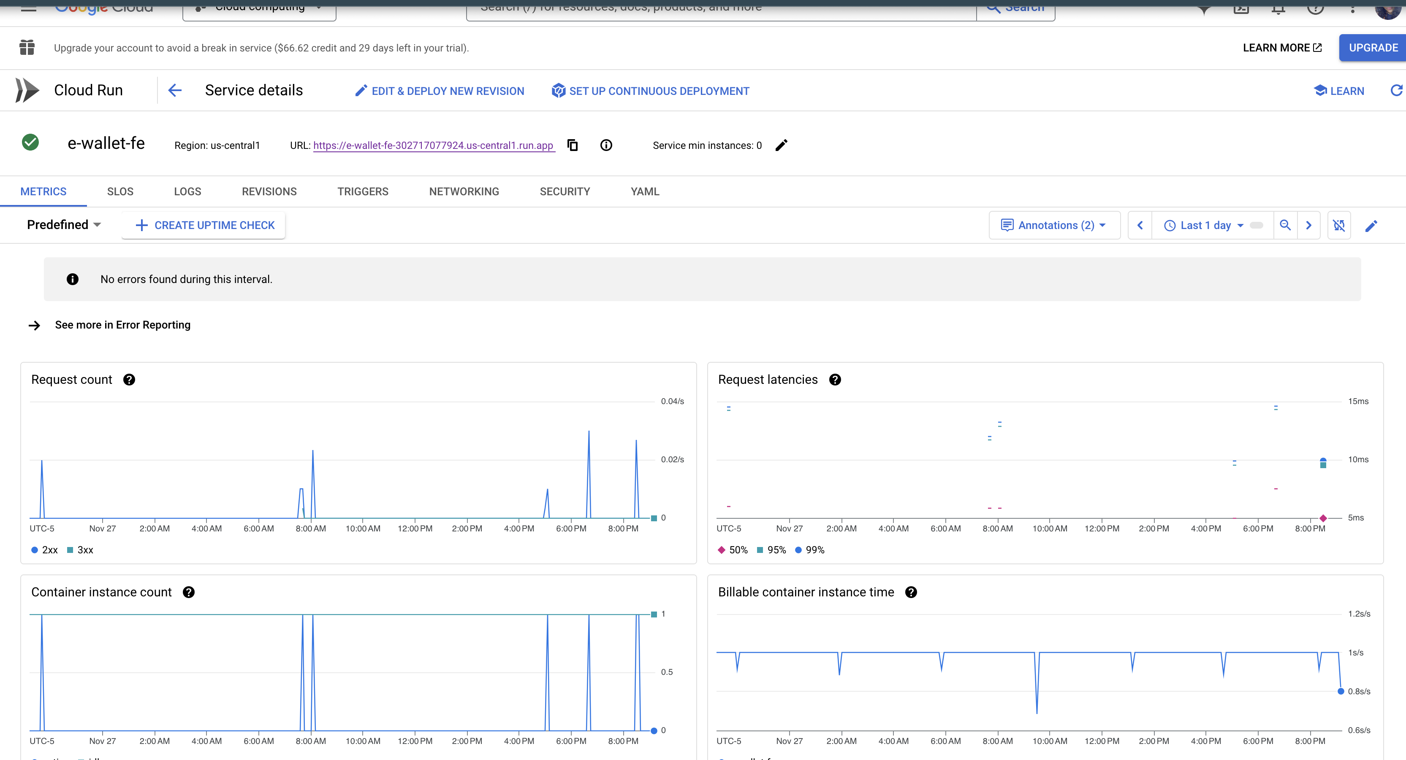
Services: Cloud Run Service

Slide 10
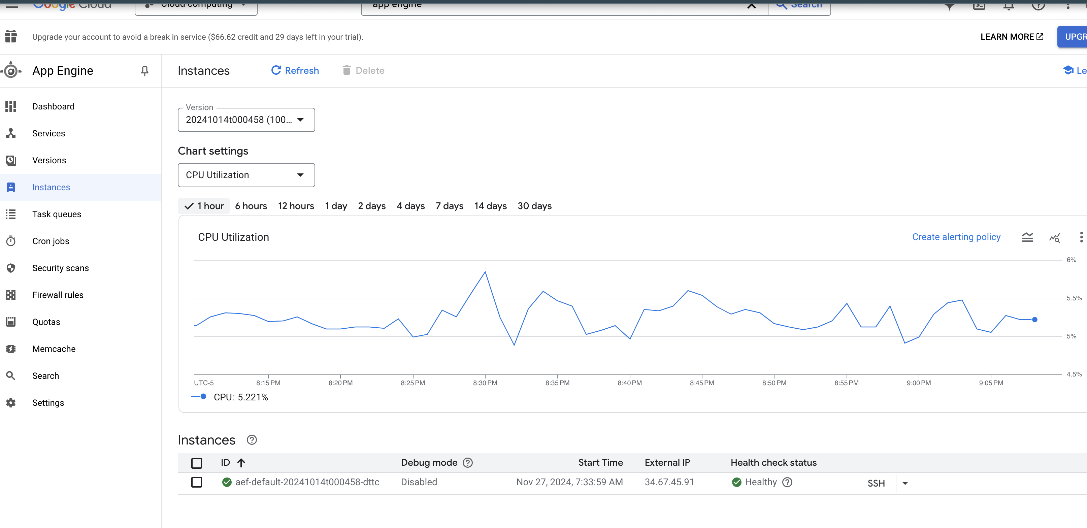
Services: App Engine for Backend Deployment

Slide 11
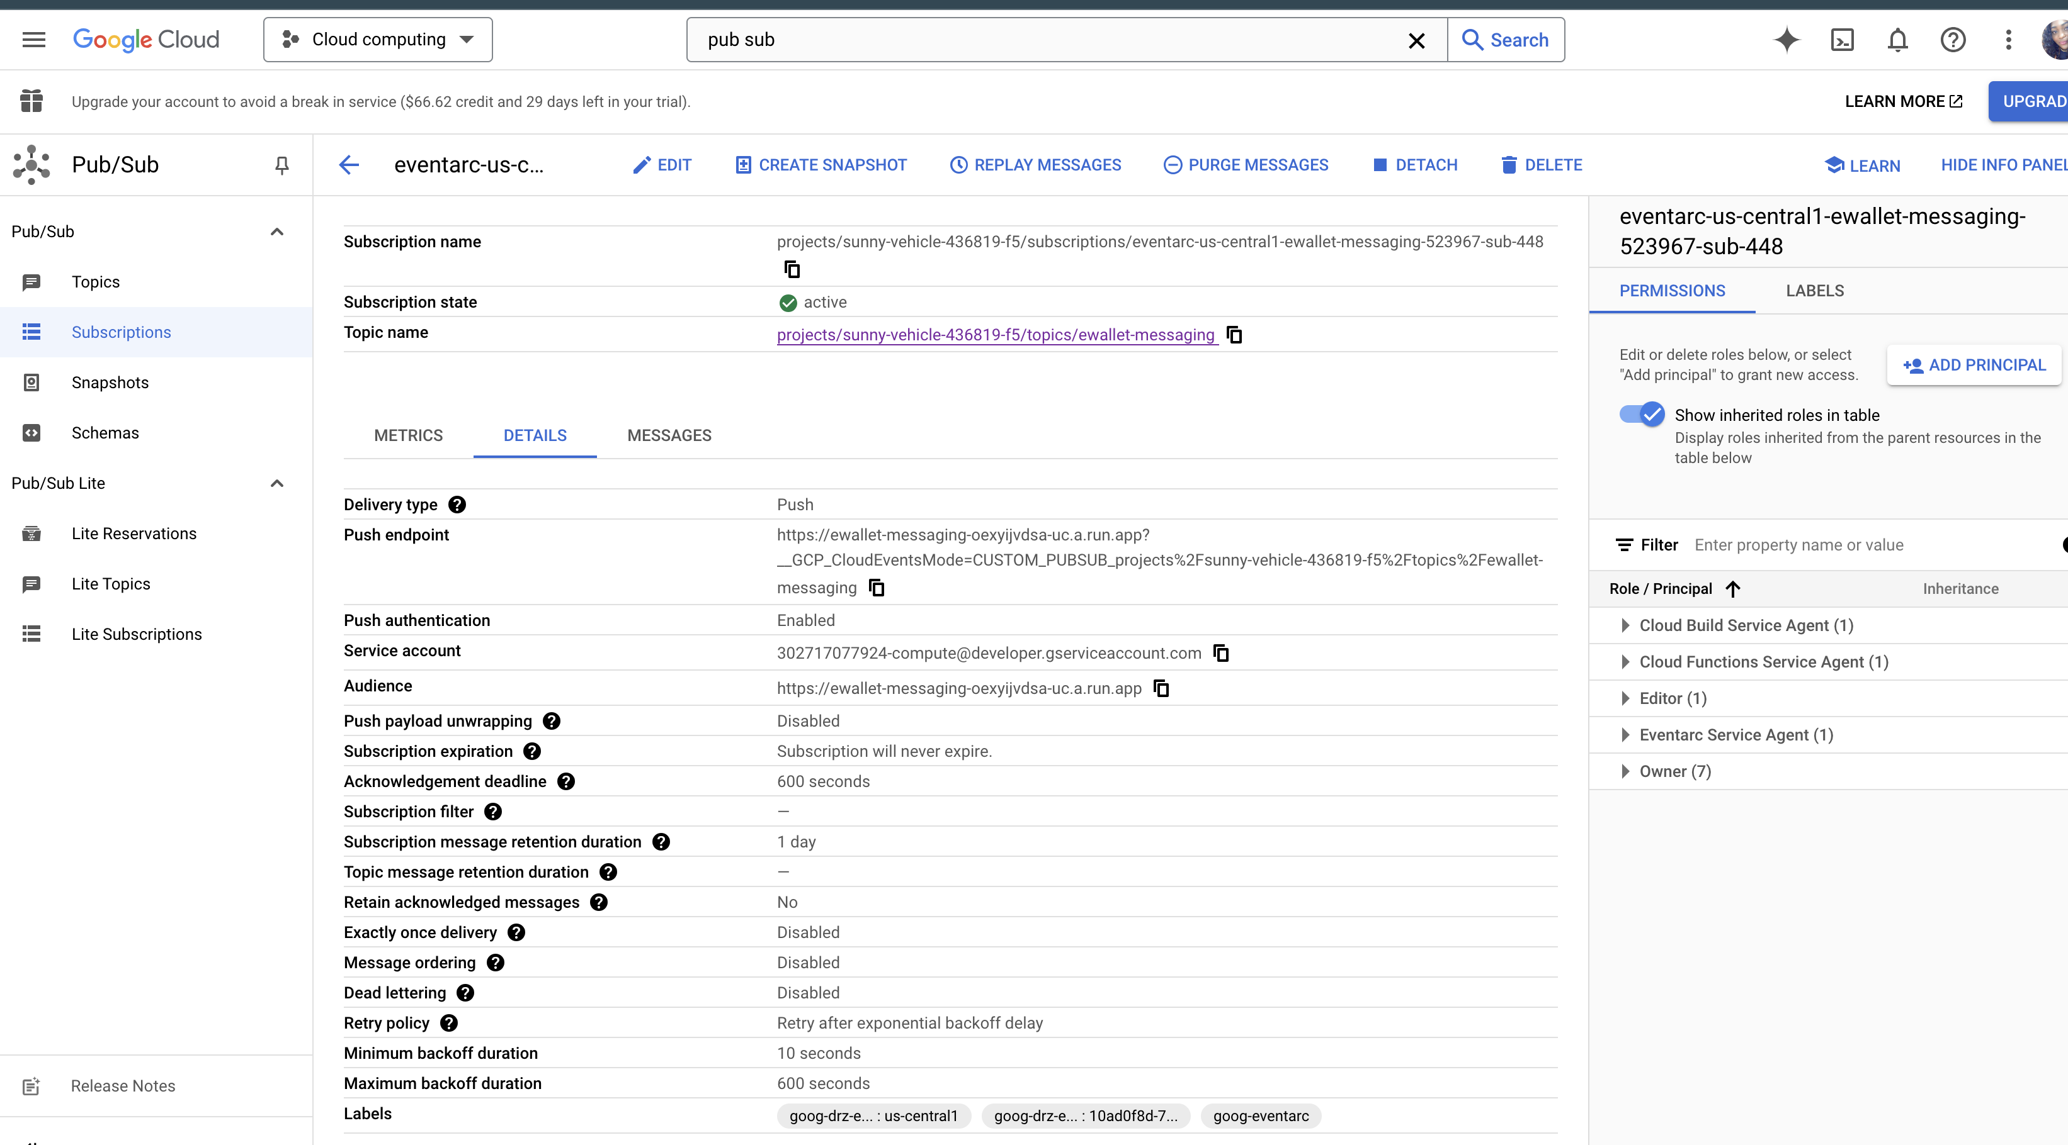
Services: Pub/Sub for Queuing requests

Slide 12
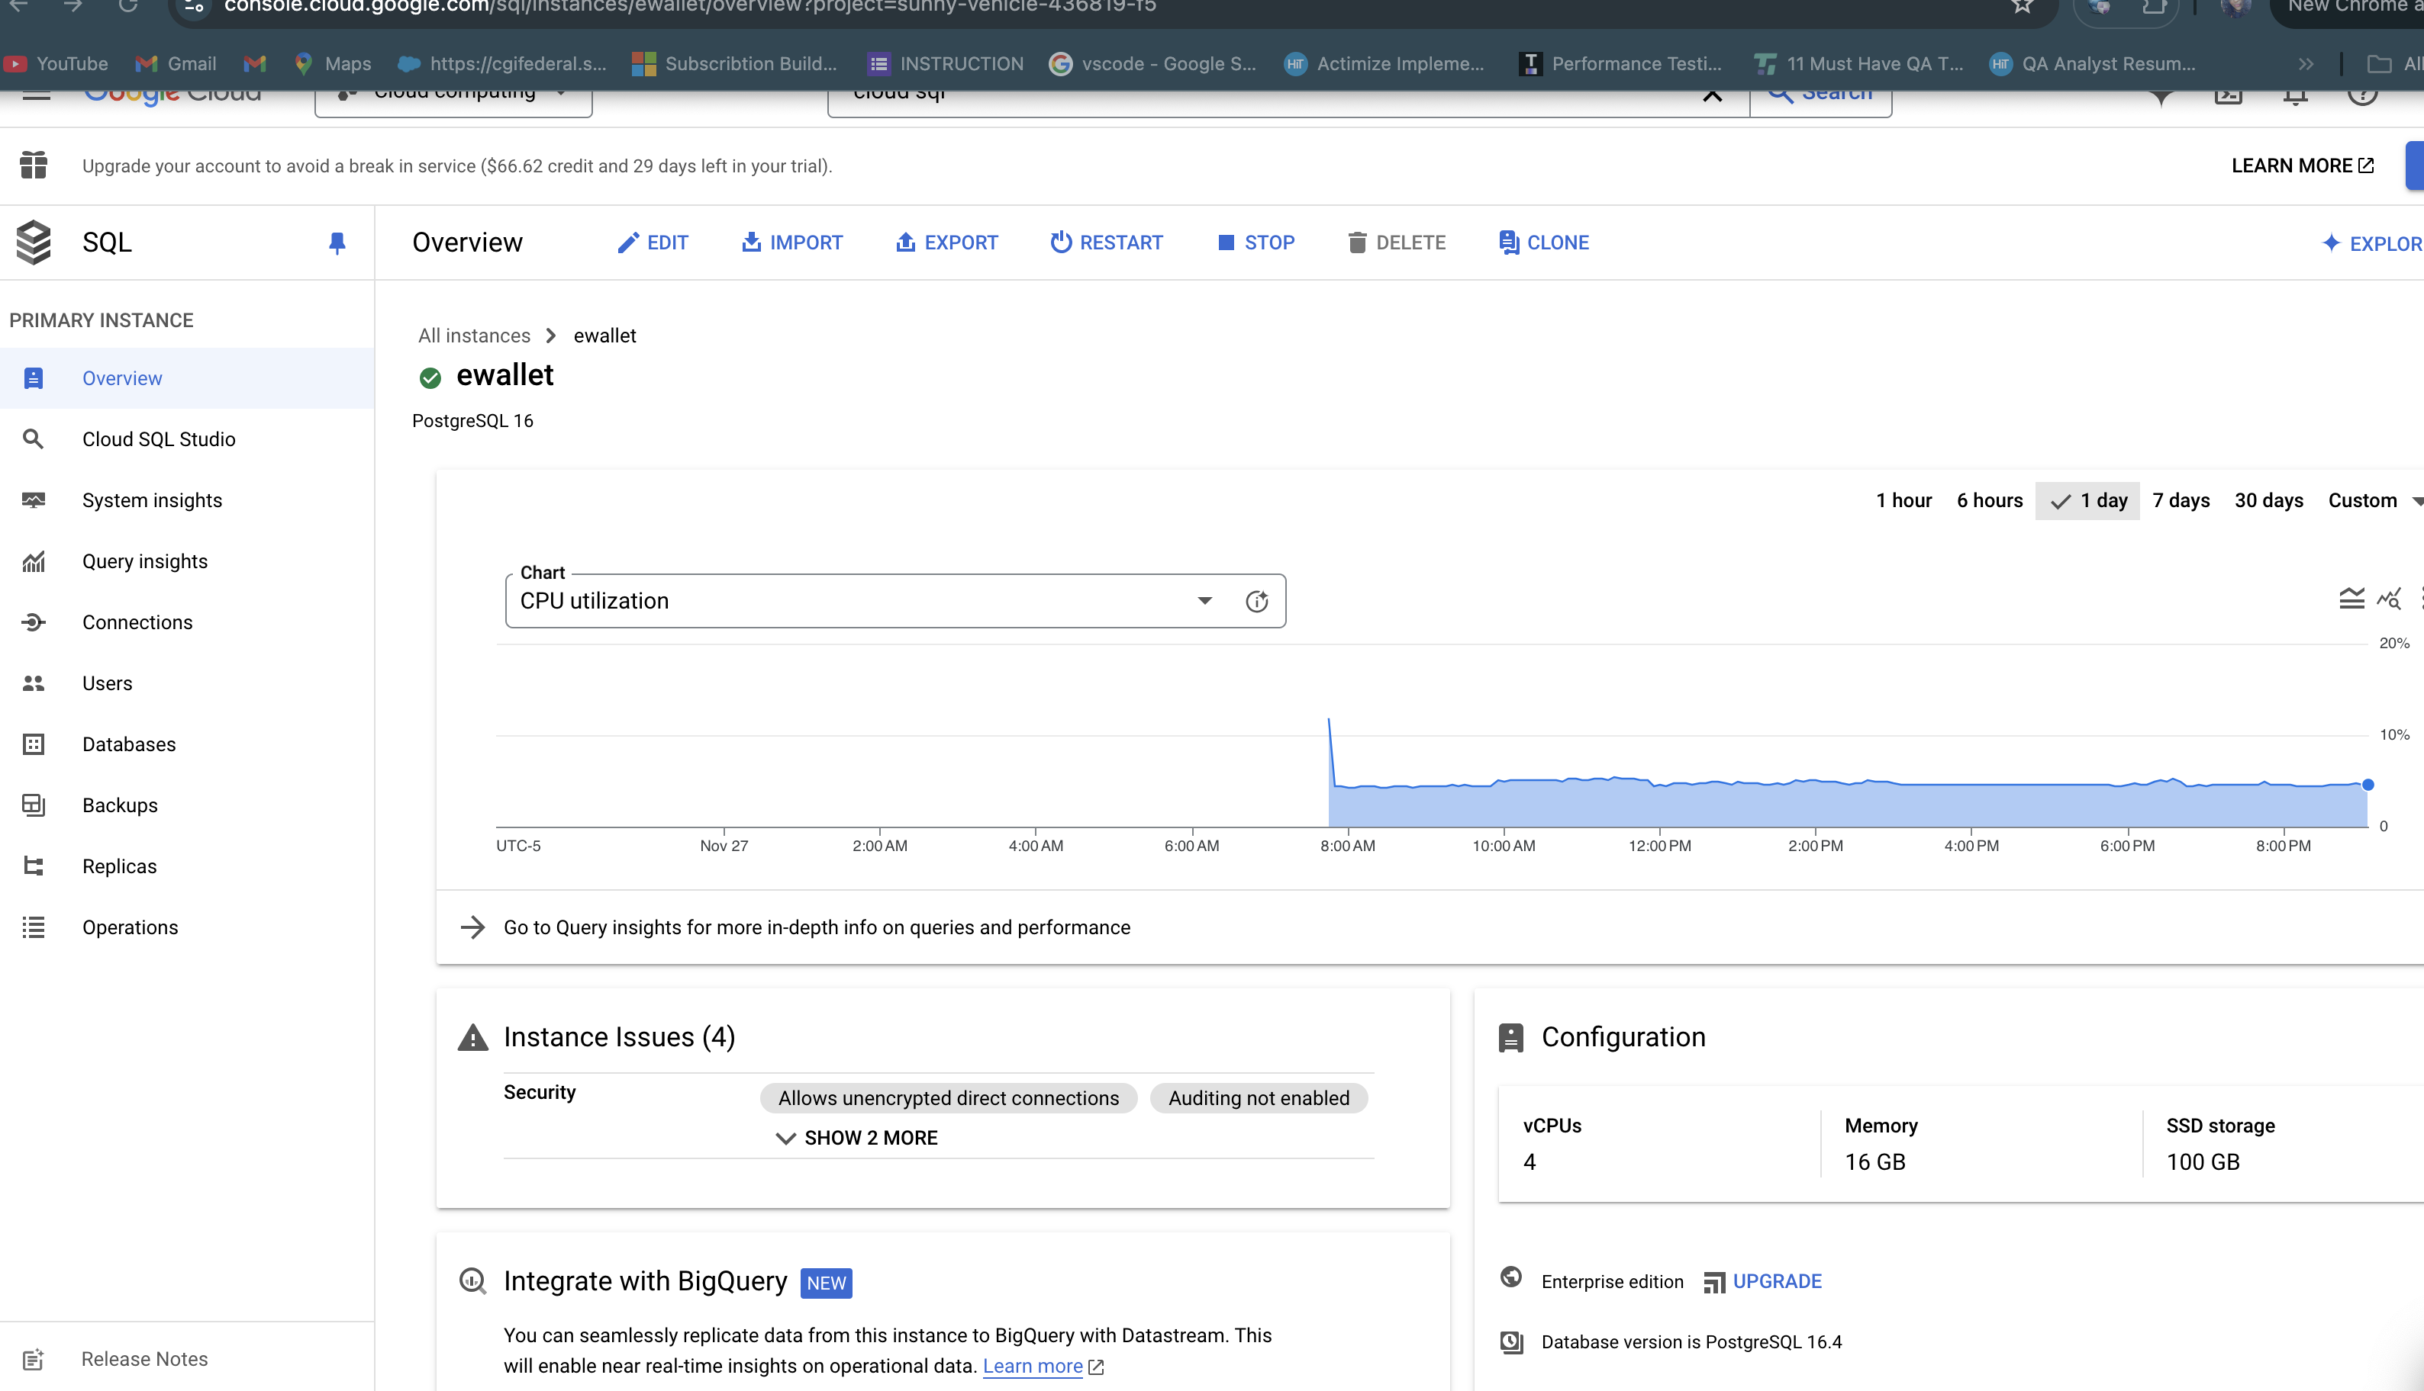
Services: Cloud SQL for database

Slide 13
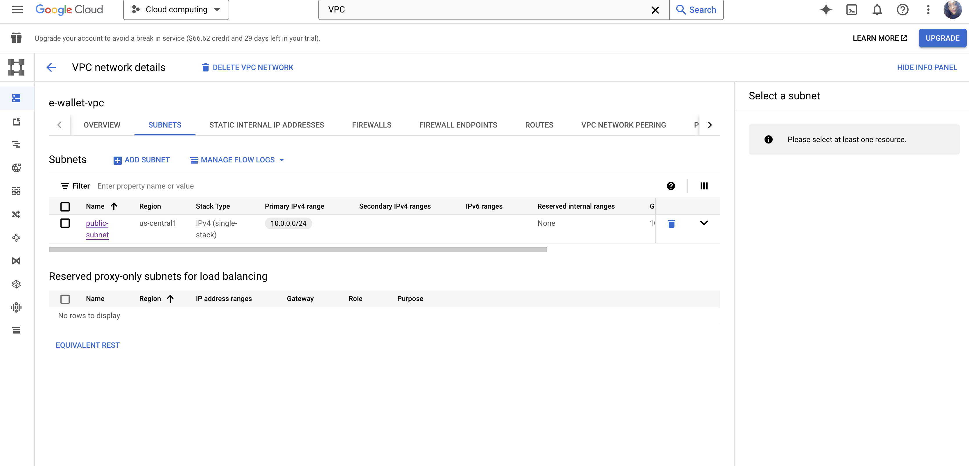
Services: Virtual Private Cloud

Slide 14
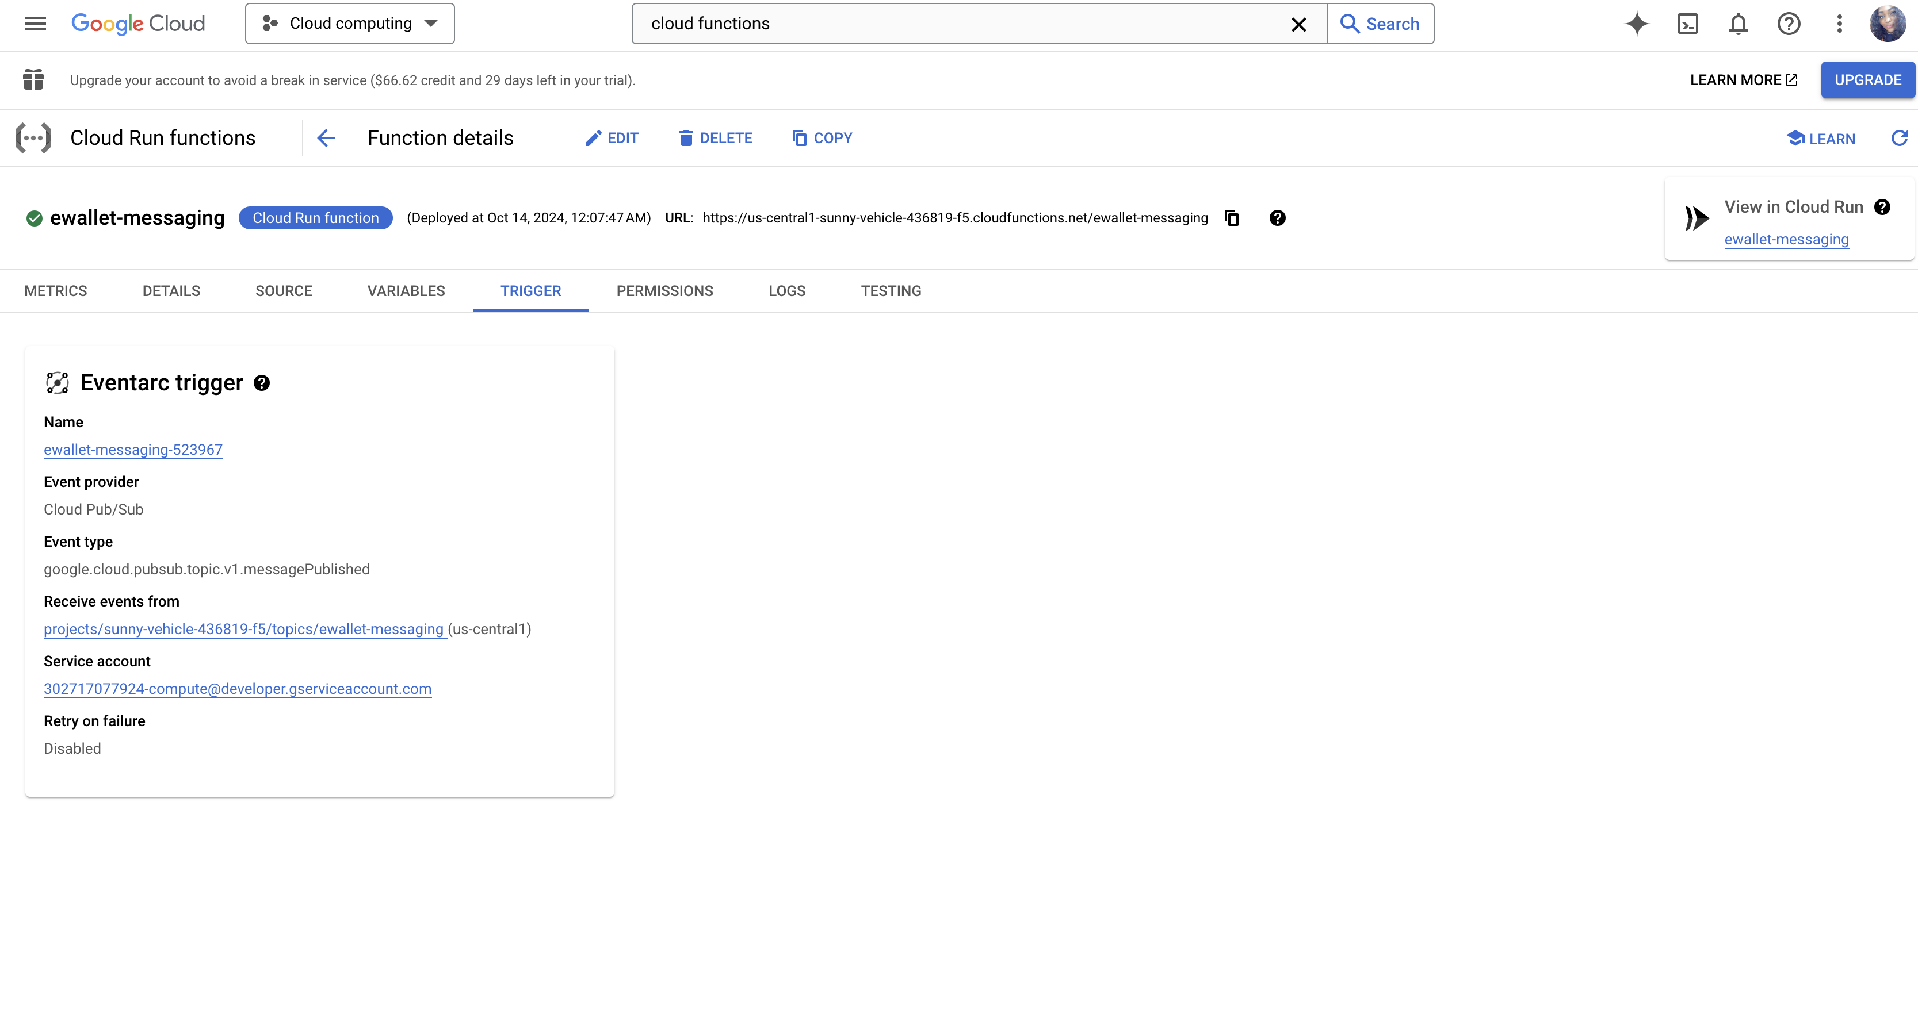
Services: Cloud Functions For delivering Email

Slide 15
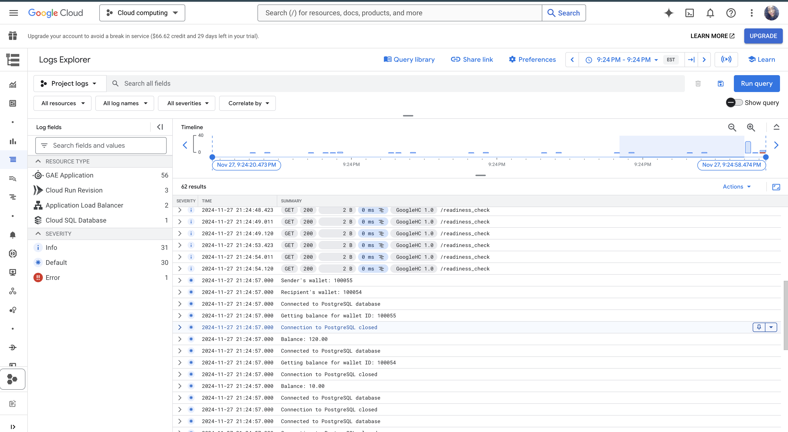
Services: Log Explorer

Slide 16
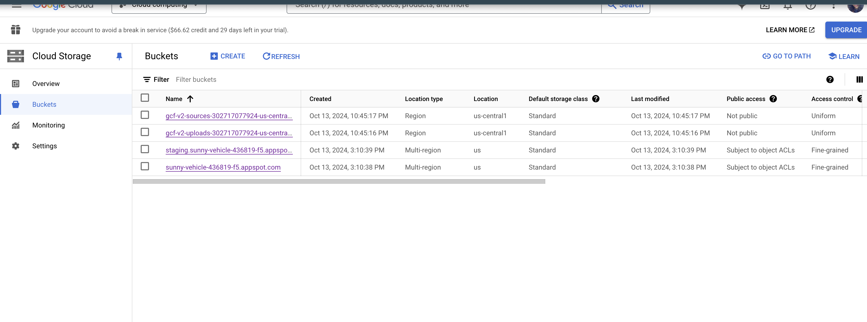
Services: Cloud storage for hosting function artifacts

Slide 17
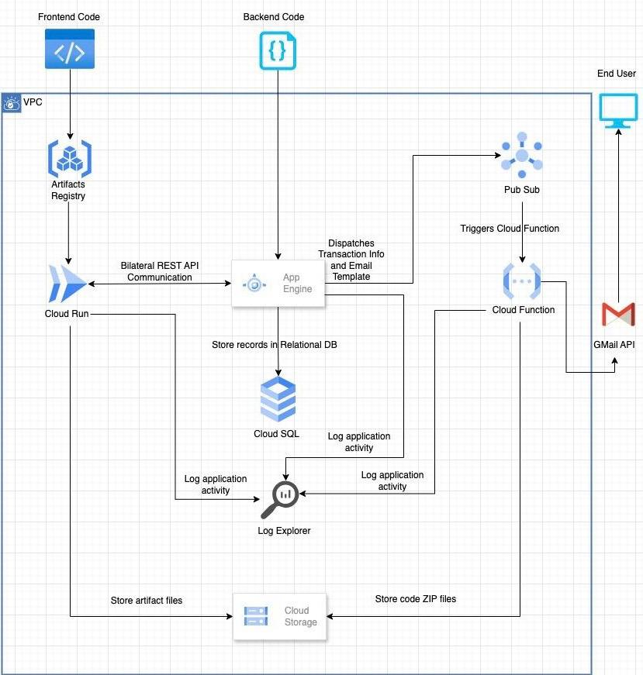
Cloud Architecture Diagram
This shows our diagrammatic representation of the development flow and user flow.

Slide 18
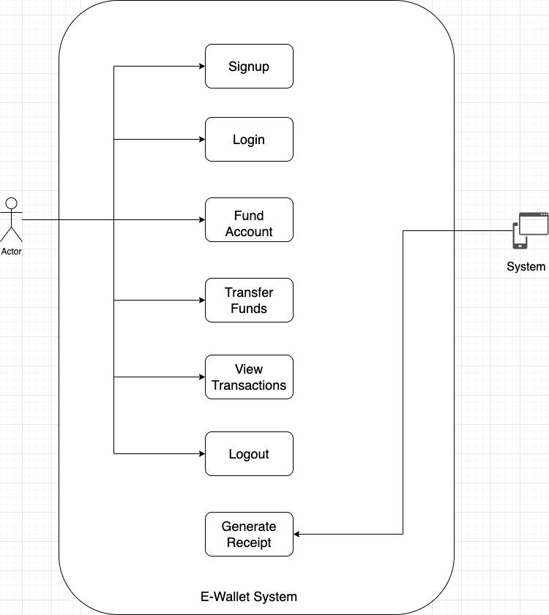
Use Case Diagram

Slide 19
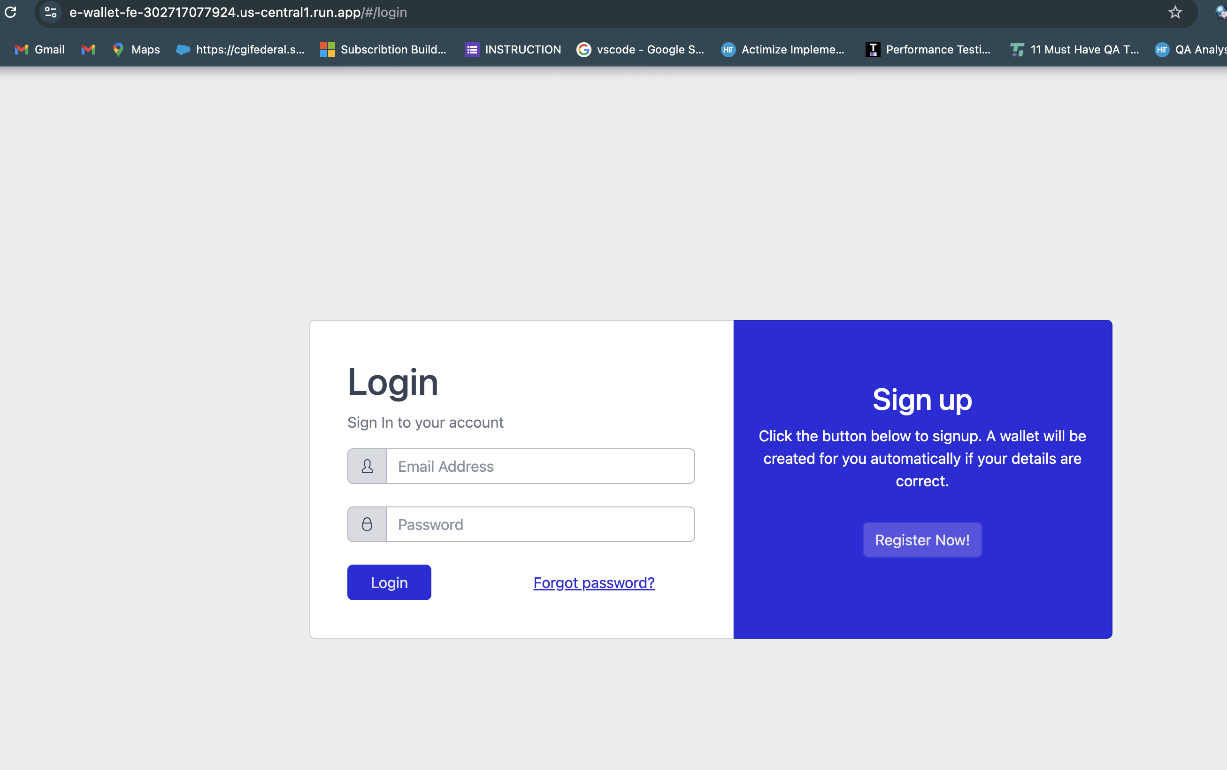
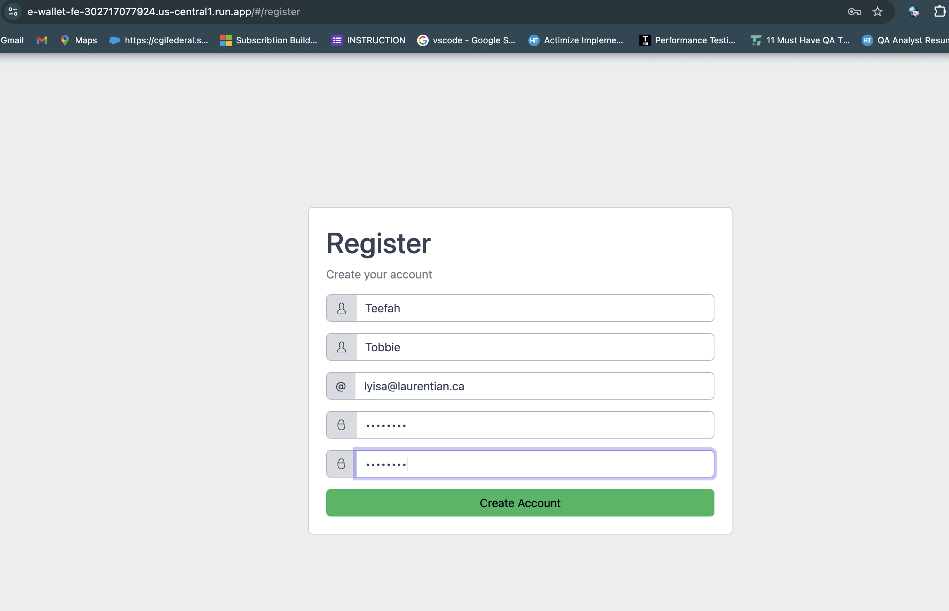
Data Ingestion for funds transfer

Slide 20
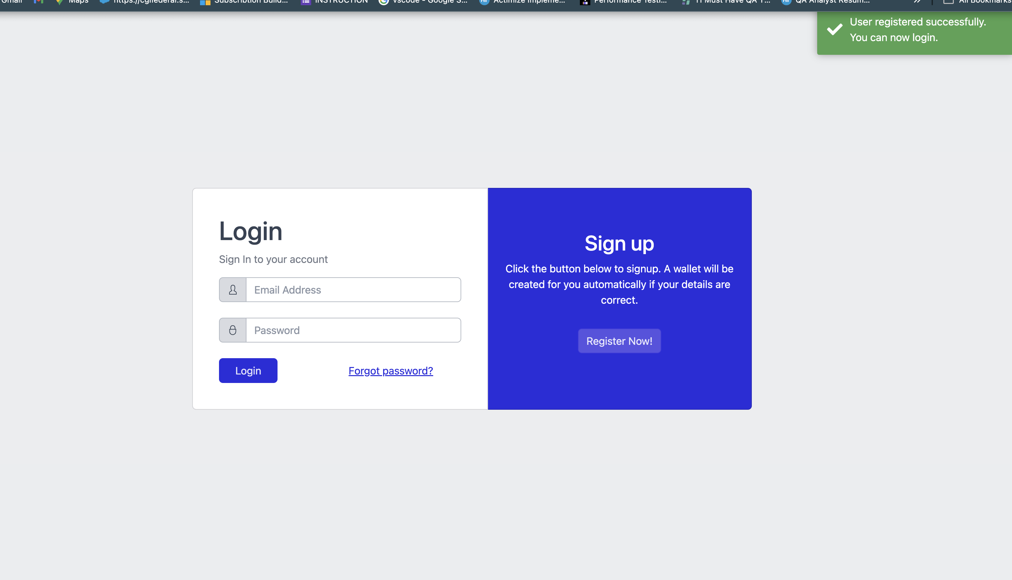
Data Ingestion for funds transfer

Slide 21
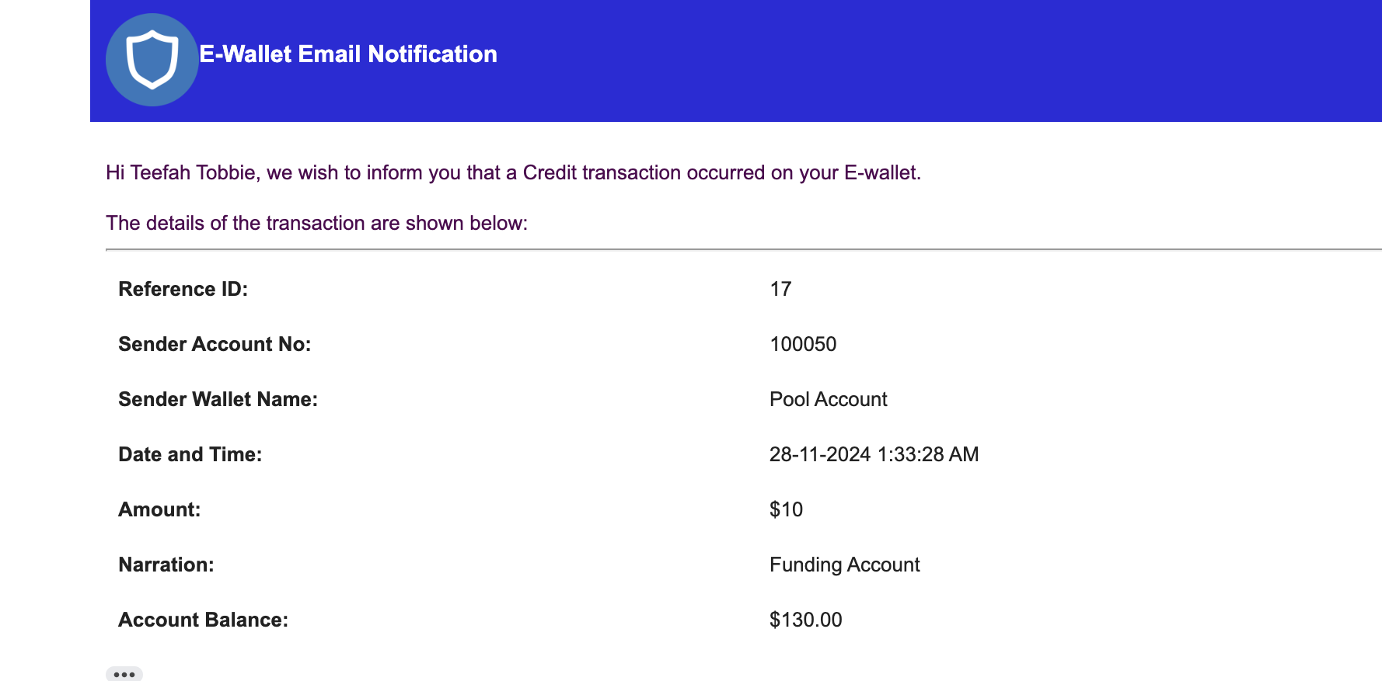
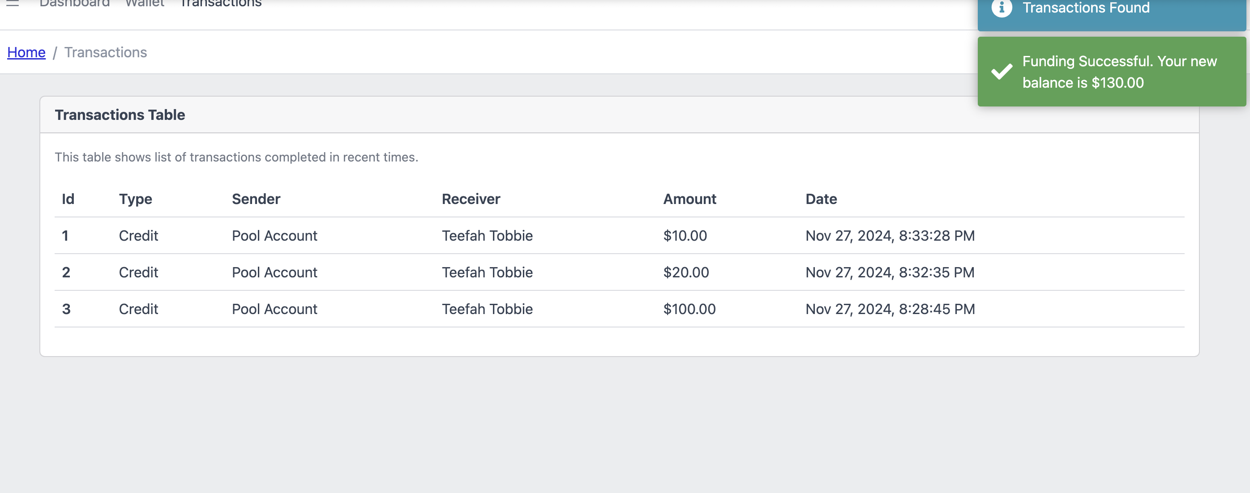
Data Ingestion for funds transfer

Slide 22
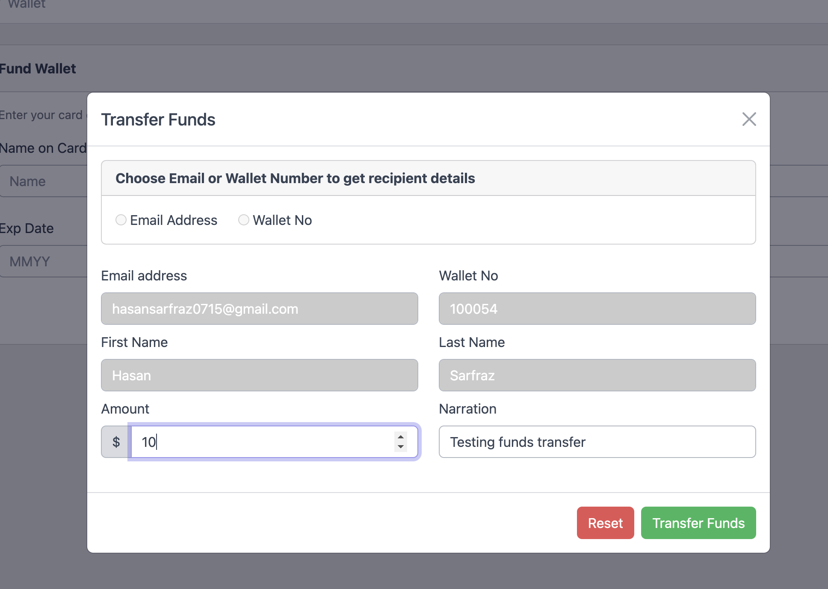
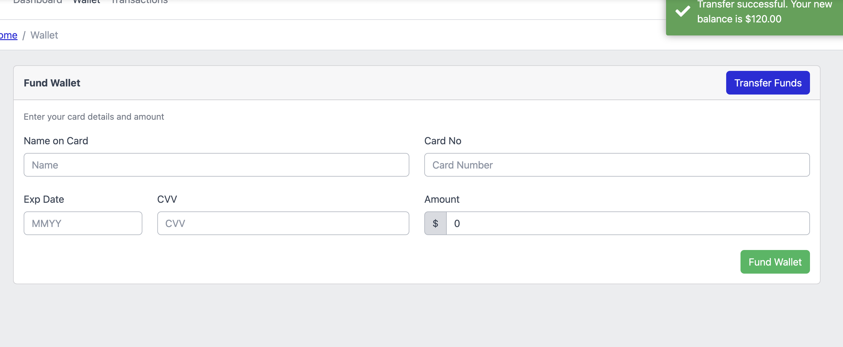
Data Ingestion for funds transfer

Slide 23
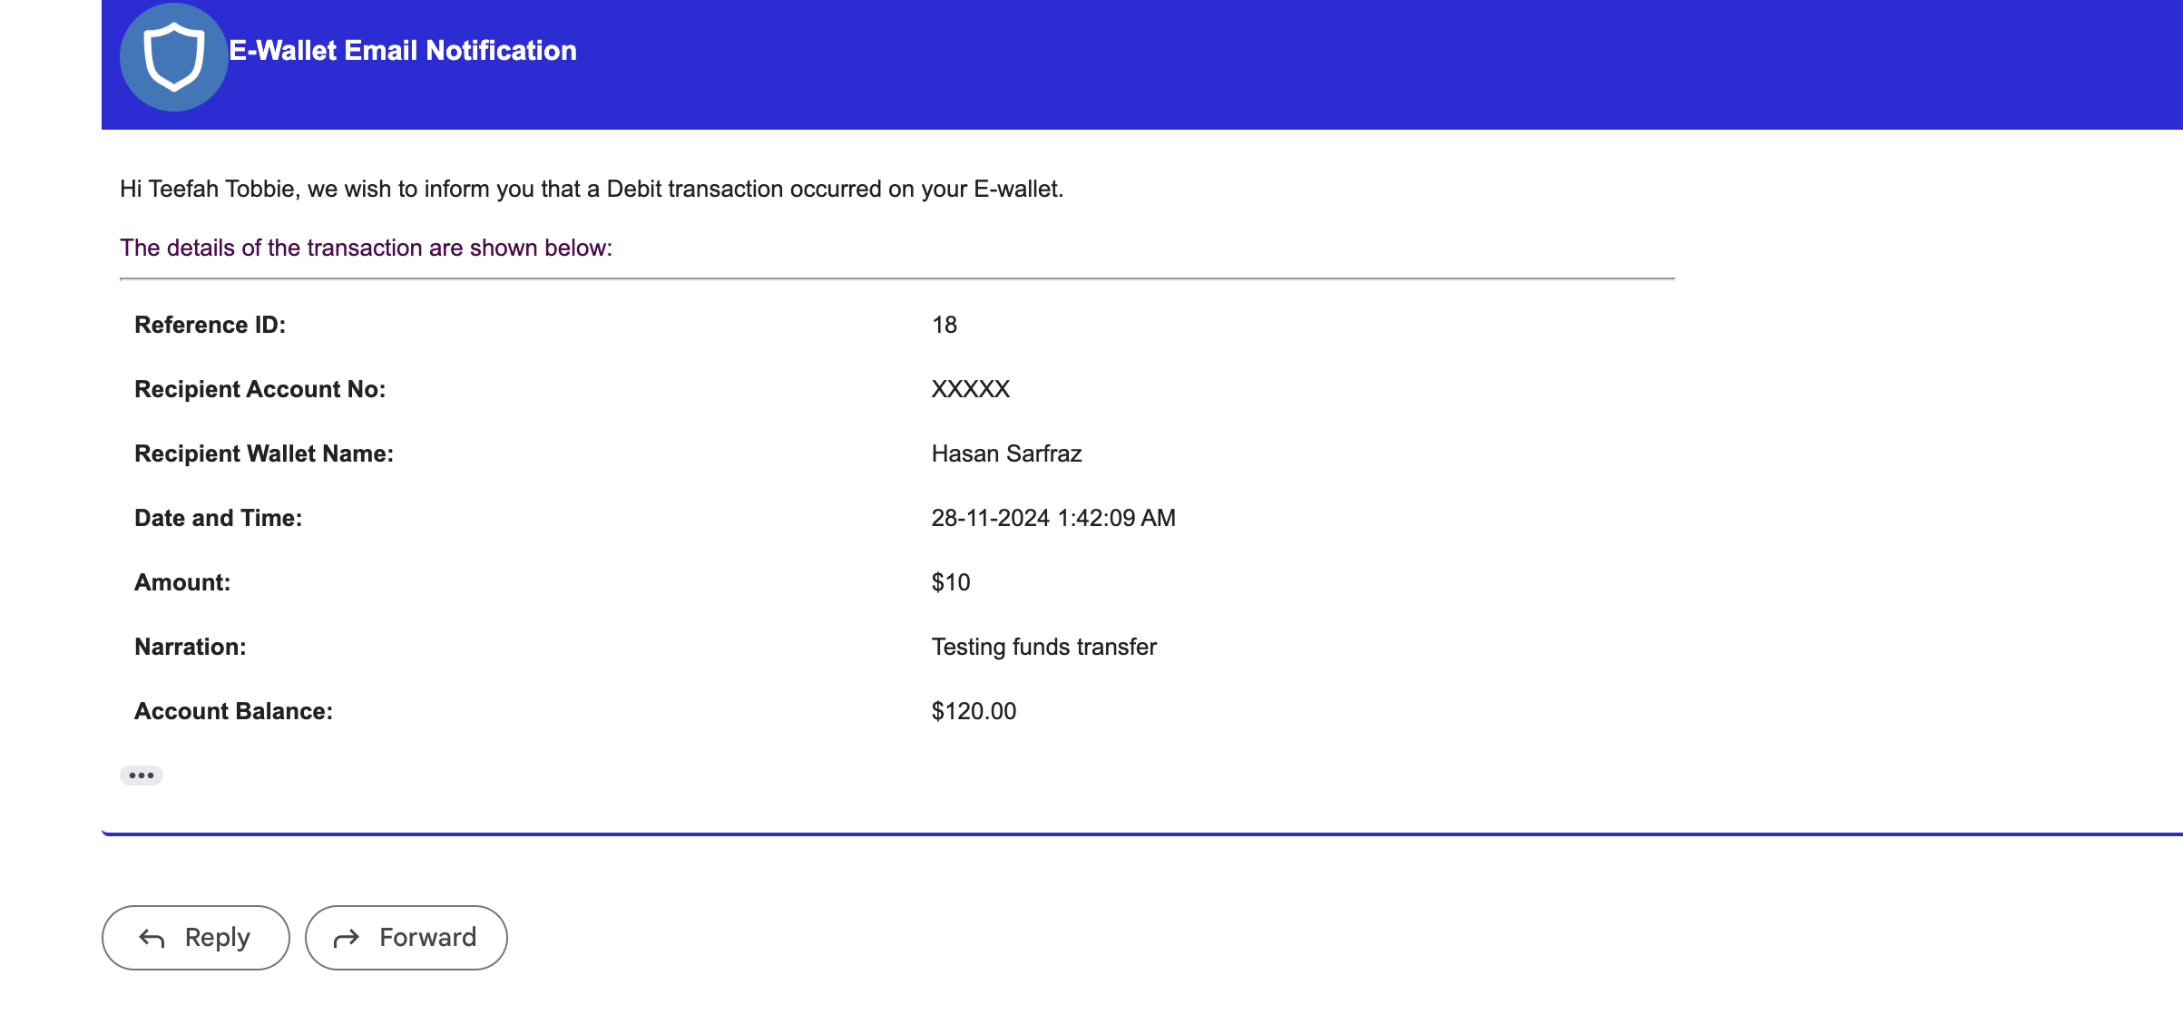
Data Ingestion for funds transfer

Slide 24

THANK YOU FOR COMING TO OUR GCP PRESENTATION.

